Slide 1

a
b
c
d
e
f
ank
ang
Let’s Build Words
g
h
i
j
k
l
ink
ing
m
n
o
p
qu
r
s
onk
ong
TAP IT OUT!
Where is the Buddy Letter?
t
u
v
w
x
y
z
unk
ung
wh
ch
sh
th
ck
-s
-es
f
l
s
all
am
an
ild
ind
old
olt
ost

Slide 2
a
b
c
d
e
f
ank
ang
Let’s build Words
g
h
i
j
k
l
ink
ing
m
n
o
p
qu
r
s
onk
ong
Where is the Blend?
Digraph?
Closed Syllable?
t
u
v
w
x
y
z
unk
ung
wh
ch
sh
th
ck
-s
-es
f
l
s
all
am
an
ild
ind
old
olt
ost

Slide 3
Lesson 26 – Intro th, ck
3 letter-syllables with a, i, and o. Intro b, digraph sh. Intro digraph ck

Slide 4
Let’s learn how to read, write and spell better by building words.
TAP IT OUT!

Slide 5
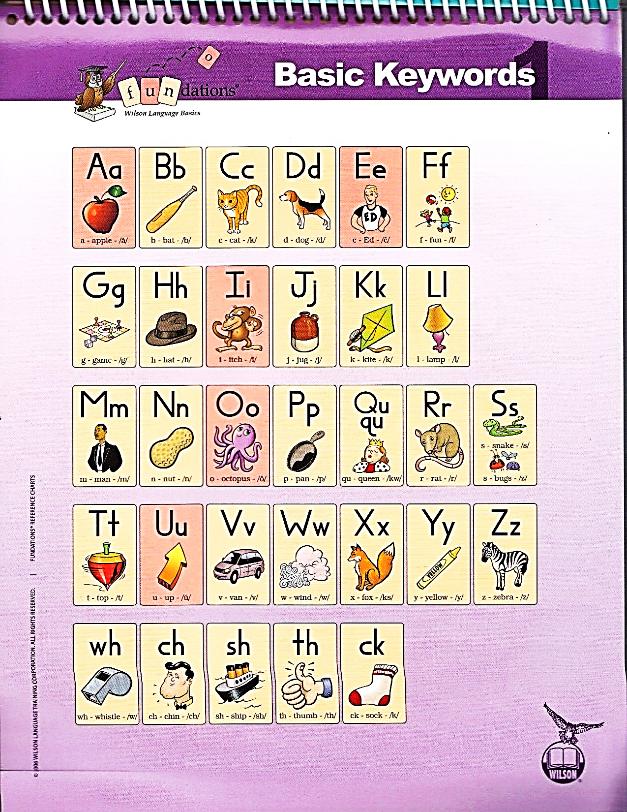
Student Notebook
pg 4
Vowels
Vowels are the most important letters, because every word and syllable needs a vowel. --- BUT, they sound so alike that we always say they we the keyword…
Echo (Clip It)
&
Draw

Slide 6
Student Notebook
pg 1
Consonants
You probably know all of this letters and their sounds but let’s make sure we are not adding any extra wrong sounds…
Echo (Clip It)
&
Draw

Slide 7
Student Notebook
pg 2
?
?
?
?
Digraphs
Some consonants are so stuck together that they form one sound even though there are two letters.
“A Digraph is 2-letters that make 1 sound!”

Slide 8
a
b
c
d
f
ank
ang
Let’s build Words
g
h
i
j
k
l
ink
ing
m
n
o
p
qu
r
s
onk
ong
Where is the Blend?
Digraph?
Closed Syllable?
u
v
w
x
y
z
unk
ung
wh
sh
th
ck
-s
-es
ch
e
t
f
l
s
all
am
an
ild
ind
old
olt
ost

Slide 9
a
b
c
d
e
f
ank
ang
Let’s build Words
g
h
j
k
l
ink
ing
m
o
p
qu
r
s
onk
ong
Where is the Blend?
Digraph?
Closed Syllable?
t
u
v
w
x
y
z
unk
ung
wh
ch
sh
ck
-s
-es
f
l
s
all
am
an
th
i
n
ild
ind
old
olt
ost

Slide 10
a
b
c
e
f
ank
ang
Let’s build Words
g
h
i
j
k
l
ink
ing
m
n
o
p
qu
r
s
onk
ong
Where is the Blend?
Digraph?
Closed Syllable?
t
v
w
x
y
z
unk
ung
wh
ch
sh
ck
-s
-es
th
u
d
f
l
s
all
am
an
ild
ind
old
olt
ost

Slide 11
a
c
d
f
ank
ang
Let’s build Words
g
h
i
j
k
l
ink
ing
m
n
o
p
qu
r
s
onk
ong
Where is the Blend?
Digraph?
Closed Syllable?
t
u
v
w
x
y
z
unk
ung
wh
ch
sh
ck
-s
-es
f
l
s
all
am
an
b
e
th
ild
ind
old
olt
ost

Slide 12
a
b
c
d
e
f
ank
ang
Let’s build Words
g
h
i
j
k
l
ink
ing
m
n
o
p
qu
r
onk
ong
Where is the Blend?
Digraph?
Closed Syllable?
t
v
w
x
y
z
unk
ung
wh
sh
th
ck
-s
-es
f
l
s
all
am
an
s
u
ch
ild
ind
old
olt
ost

Slide 13
a
b
c
d
e
f
ank
ang
Let’s build Words
g
h
j
k
l
ink
ing
m
n
o
p
qu
r
s
onk
ong
Where is the Blend?
Digraph?
Closed Syllable?
t
u
v
w
x
y
z
unk
ung
wh
ch
sh
-s
-es
th
i
ck
f
l
s
all
am
an
ild
ind
old
olt
ost

Slide 14
a
b
c
d
e
f
ank
ang
Let’s build Words
g
h
j
k
l
ink
ing
m
n
o
p
r
s
onk
ong
Where is the Blend?
Digraph?
Closed Syllable?
t
u
v
w
x
y
z
unk
ung
wh
ch
sh
th
-s
-es
qu
i
ck
f
l
s
all
am
an
ild
ind
old
olt
ost

Slide 15
b
c
d
e
f
ank
ang
Let’s build Words
g
h
i
j
k
l
ink
ing
m
n
o
p
r
s
onk
ong
Where is the Blend?
Digraph?
Closed Syllable?
t
u
v
w
x
y
z
unk
ung
wh
ch
sh
th
-s
-es
f
l
s
all
am
an
qu
a
ck
ild
ind
old
olt
ost

Slide 16
a
b
c
d
e
f
ank
ang
Let’s build Words
g
h
j
k
l
ink
ing
m
n
o
p
r
s
onk
ong
Where is the Blend?
Digraph?
Closed Syllable?
u
v
w
x
y
z
unk
ung
wh
ch
sh
th
ck
-s
-es
qu
i
t
f
l
s
all
am
an
ild
ind
old
olt
ost

Slide 17
a
b
c
d
e
f
ank
ang
Let’s build Words
g
h
j
k
l
ink
ing
m
n
o
p
qu
r
s
onk
ong
Where is the Blend?
Digraph?
Closed Syllable?
t
u
v
w
x
y
unk
ung
ch
sh
th
ck
-s
-es
wh
i
z
f
l
s
all
am
an
ild
ind
old
olt
ost

Slide 18
a
b
c
d
f
ank
ang
Let’s build Words
g
h
i
j
k
l
ink
ing
m
o
p
qu
r
s
onk
ong
Where is the Blend?
Digraph?
Closed Syllable?
t
u
v
x
y
z
unk
ung
w
ch
sh
th
ck
-s
-es
f
l
s
all
am
an
wh
e
n
ild
ind
old
olt
ost

Slide 19
a
b
c
d
e
f
ank
ang
Let’s build Words
g
h
j
k
l
ink
ing
m
n
o
p
qu
r
s
onk
ong
Where is the Blend?
Digraph?
Closed Syllable?
t
u
v
x
y
z
unk
ung
w
sh
th
ck
-s
-es
f
l
s
all
am
an
wh
i
ch
ild
ind
old
olt
ost

Slide 20
a
b
c
d
e
f
ank
ang
Let’s build Words
g
h
i
j
k
l
ink
ing
m
n
o
p
qu
r
s
onk
ong
Where is the Blend?
Digraph?
Closed Syllable?
t
u
v
w
x
y
z
unk
ung
wh
ch
sh
th
ck
-s
-es
f
l
s
all
am
an
ild
ind
old
olt
ost

Slide 21
a
b
c
d
e
f
ank
ang
Let’s build Words
g
h
i
j
k
l
ink
ing
m
n
o
p
qu
r
s
onk
ong
Where is the Blend?
Digraph?
Closed Syllable?
t
u
v
w
x
y
z
unk
ung
wh
ch
sh
th
ck
-s
-es
f
l
s
all
am
an
ild
ind
old
olt
ost

Slide 22
a
b
c
d
e
f
ank
ang
Let’s build Words
g
h
i
j
k
l
ink
ing
m
n
o
p
qu
r
s
onk
ong
Where is the Blend?
Digraph?
Closed Syllable?
t
u
v
w
x
y
z
unk
ung
wh
ch
sh
th
ck
-s
-es
f
l
s
all
am
an
ild
ind
old
olt
ost

Slide 23
3. Word Cards Time!
TAP IT OUT!

Slide 24
4. Charting TIME!
TAP IT OUT!

Slide 25
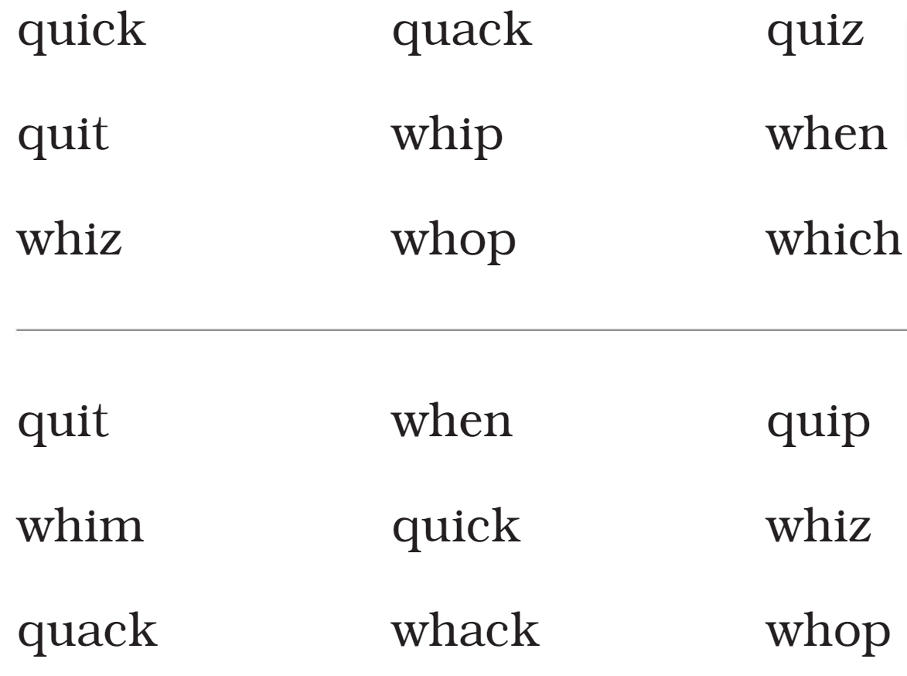
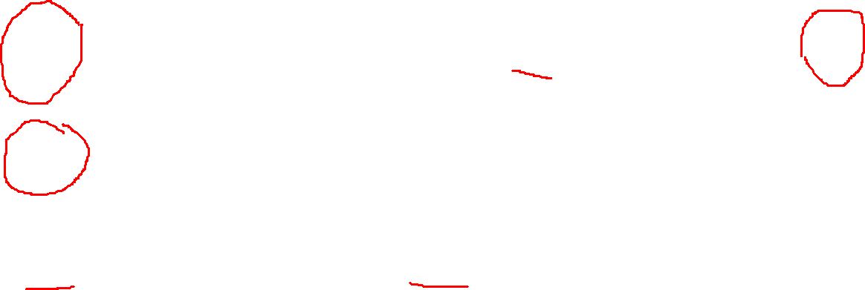

Slide 26
5. Sentence Reading Time!
TAP IT OUT!

Slide 27

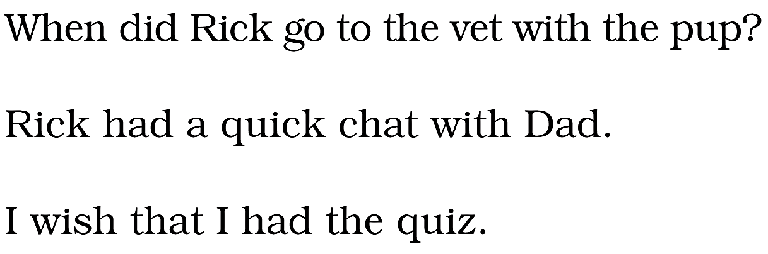
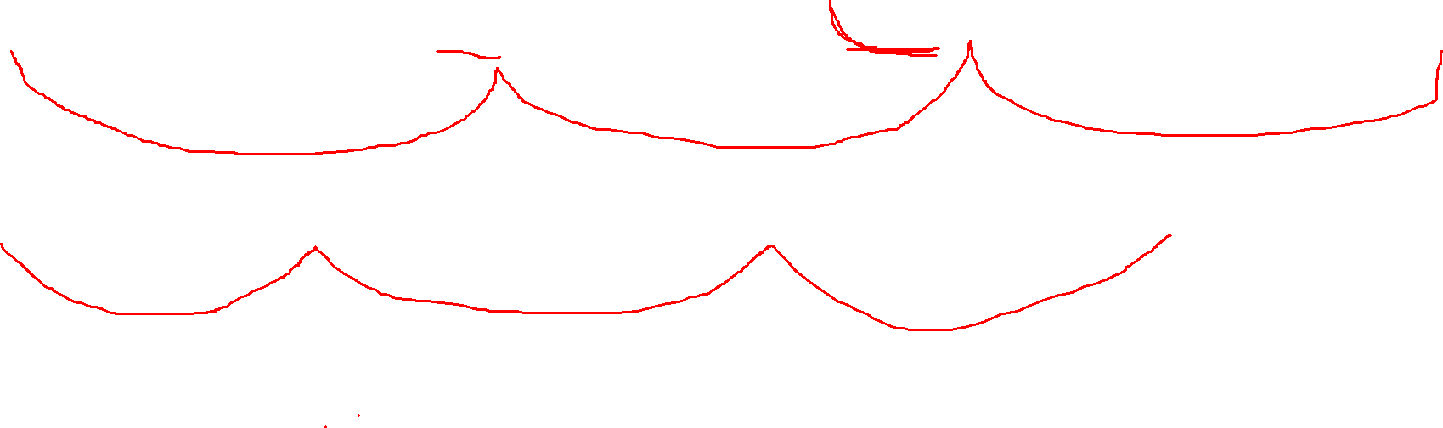

Slide 28
Use your journal.
Name
Substep 1.2
Lesson Number 4
Date: 10/8/20
8. Dictation TIME!
TAP IT OUT!
Say
Tap
Spell
Spell as you write

Slide 29
8. Dictation
Mr. Figueroa 1/14/2021 1.2
e
u
g
sh
ch
Mr. Figueroa 1/14/2021 1.2
chap
thud
moth
much
wet
I wish to jog on that path.

Slide 30
8. Dictation
Mr. Figueroa 1/14/2021 1.2
Mr. Figueroa 1/14/2021 1.2

Slide 31

Have a great day!

Slide 32
6. Quick Drill in Reverse
(Magnetic Journals)
TAP IT OUT!

Slide 33
7. Spelling
(Magnetic Journals)
Say
Say w/o Suffix
Tap
Spell
Build as you Spell
Scoop and Read
Spell it Back
TAP IT OUT!

Slide 34
Use your journal.
Name
Substep 1.1
Lesson Number 2
Date: 10/1/20
8. Dictation TIME!
TAP IT OUT!
Say
Tap
Spell
Spell as you write

Slide 35
8. Dictation
Mr. Figueroa 10/1/2020
a
I
n
t
g
Mr. Figueroa 10/1/2020
mad
sag
nag
nip
mid

